Slide 1
Analysing IAA for implicit discourse relations in Prague Dependency Treebank – Consolidated 2.0
HLV workshop, August 2026
Pavlína Synková, Jiří Mírovský

Slide 2
Motivation
ongoing annotation of implicit discourse relations in Prague Dependency Treebank – Consolidated 2.0 (PDT-C 2.0)
very few reports about IAA on implicit relations
many contexts in which multiple similarly plausible interpretations exist > not all disagreement ≠ error
every human annotation contains errors

Slide 3
Goals
report results of IAA in ongoing annotation
analyse contexts where annotators disagree
find out what proportion of cases with disagreement involve misinterpretations or errors

Slide 4
Overview
Prague Dependency Treebank – Consolidated 2.0
ongoing annotation of implicit discourse relations
analysis of dis/agreement

Slide 5
Prague Dependency Treebank – Consolidated
(PDT-C)

Slide 6
Prague Dependency Treebank – Consolidated (PDT-C)
Czech texts
more than 3 million tokens (175 K sentences )
genre-diversified (written text, translated texts, transcripts of spoken texts) > 4 subcorpora
multi-layer manual annotation
morphology, surface and deep dependency syntax (dependency trees)
semantic-pragmatic annotations: ellipsis resolution, coreference and bridging relations, discourse relations, information structure, scope of negation and focalizers
Hajič et al. (2024): Prague Dependency Treebank - Consolidated 2.0. Data/software, ÚFAL, MFF UK, Prague, Czech Republic. LINDAT/CLARIAH-CZ: http://hdl.handle.net/11234/1-5813

Slide 7
PDT-C: parts
  Prague Dependency Treebank
    49 K sentences, Czech written journalistic texts from nineties of 20th century
  Prague Czech-English Dependency Treebank – Czech part
    49 K sentences, manual Czech translation of Wall Street Journal section of the Penn Treebank with 1:1 sentence alignment
  Prague Dependency Treebank of Spoken Czech
    74 K sentences, transcript of 120 hours of spontaneous conversations (shoa testimonies, reminiscences about personal photographs)
  Faust
    3 K sentences, short, often non-standard pieces of texts, user-generated input during the development of web translator

Slide 8
PDT-C: discourse relations annotation
explicit discourse relations in all parts (82K relations)
primary and secondary connectives
colon, semicolon and dash considered as primary connectives
Prague taxonomy: 22 semantic types/senses
in Prague Discourse Treebank 4.0 (Mírovský and Synková, 2026) data available in Prague (PML) and PDTB format and taxonomy

Slide 9
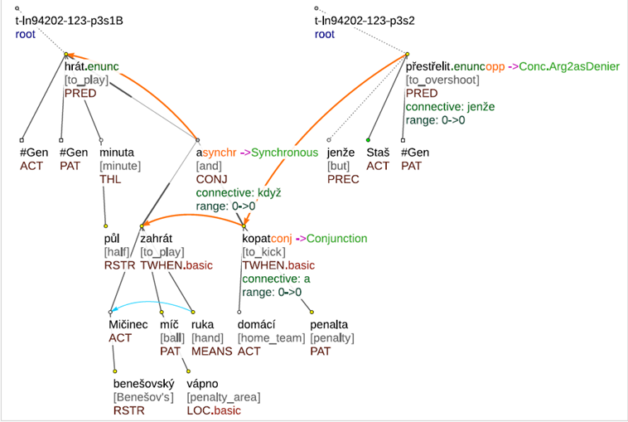
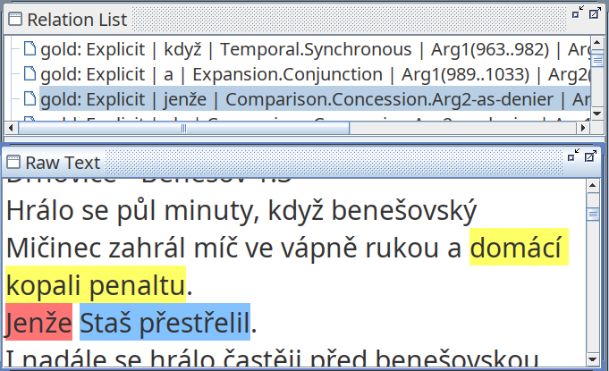
PDT-C: discourse relations annotation (PDiT 4.0)
The game was played for half a minute when Benešov's Mičinec played the ball in the penalty area with his hand and the home team kicked a penalty.
But Staš overshot.

Slide 10
Prague sense taxonomy
symmetric relations (semantic of arguments is the same) in grey
for asymmetric relations semantics of arguments marked in the data by arrow orientation (e.g. goes from reason to result in reason-result relation)
temporal | contingency | comparison | expansion
precedence - succession | reason-result | confrontation | conjunction
synchrony | pragmatic reason-result | opposition | exemplification
 | purpose | pragmatic opposition | specification
 | explication | restrictive opposition | generalization
 | condition | concession | equivalence
 | pragmatic condition | correction | conjunctive alternative
 |  | gradation | disjunctive alternative

Slide 11
Implicit discourse relations annotation

Slide 12
Implicit relations annotation
implicit relations on the data sample consisting of 2,5 K sentences (approx. 1400 relations, PDiT-EDA, Zikánová et al. 2019)
ongoing initiative (from May 2025) aims to cover at least some subcorpora of PDT-C
to cover whole structure of each document
  implicit relations,
  entity-based relations, no relations, inter-sentential attribution relations, same-unit
  metatexts, heading, locations, metastructure comment
  dialogue dimension of text
11 annotators, 10 weeks of training
25% of data annotated in double

Slide 13
Implicit relations annotation
implicit relations
  assign sense/semantic label, insert appropriate connective
  select the exact signal which lead an annotator to annotate a given discourse type
  Máme zastaralé zařízení vysokých škol, musíme je modernizovat. Máme poškozené životní prostředí, musíme je vylepšovat.
  <Our universities have outdated facilities; we need to modernize them. Our environment is damaged; we need to improve it.>
  > conjunction, and, signal: máme, máme/construction
  signal annotation inspired by Das and Taboada (2018) but significantly modified

Slide 14
Implicit relations annotation
annotated separately for intra- and inter-sentential relations
intra-sentential relations annotated directly in trees
  filelists for syntactic structures where implicit relations occur
    coordinated clauses without a connective
    relative clauses
    parentheses
inter-sentential relations annotated in a table format which contains all previous stages of annotation – each row where annotation is needed is marked
  will be transferred into trees

Slide 15
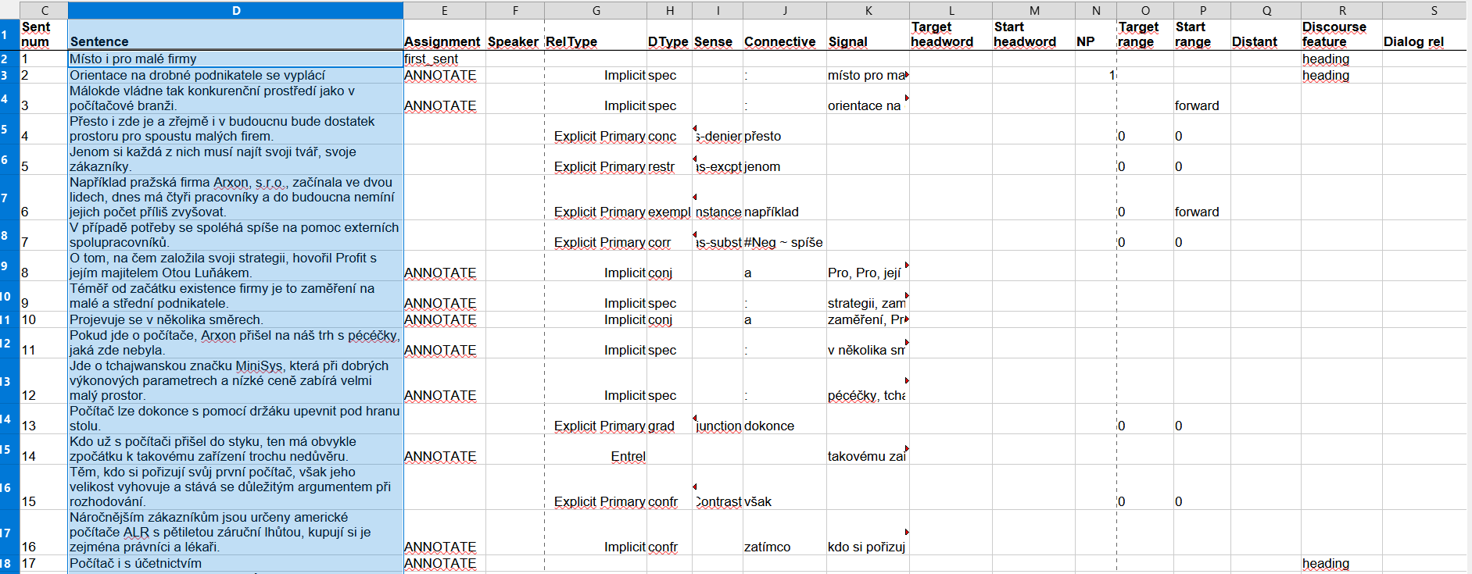

Slide 16
Dis/agreement analysis

Slide 17
Dis/agreement analysis: overview
data from PDT subcorpora
inter-sentential relations: 735 sentences
intra-sentential relations: 100 random sentences with a coordinated structure with no connective + 100 random sentences with a relative clause

Slide 18
Dis/agreement analysis: inter-sentential relations
735 rows ~ sentences from inter-sentential annotation which were annotated in double
480 items where some annotation should be added (in rest: annotation from previous stages)
394 items where both annotators indicated implicit relation
IAA on sense: 59% with Cohen´s kappa 0.45

Slide 19
Dis/agreement analysis: inter-sentential relations
all contexts analyzed manually
394 contexts where both annotators have implicit relation
160 contexts where annotators disagreed on discourse type (41% of disagreement – cf. Hoek et al. (2021): 44%)
in 130 cases both discourse senses were equally appropriate
in 30 cases one sense was inappropriate
approx. 8% of all relations are errors/annotation noise
cf. Yung et al. (2026): 11% of errors

Slide 20
Dis/agreement analysis: inter-sentential relations
inappropriate conjunction × appropriate detail
<During the roughly three-hour meeting, the two politicians focused primarily on their foreign policy activities.
The president and prime minister briefed each other on the objectives of upcoming foreign trips and the results of recent ones.>
appropriate conjunction × detail
<Social harmony in this overcrowded neighborhood was hanging by a thread.
It seemed that no one was sparing the businessman who wants to transform the Kladno steel giant into a thriving, modern company.>

Slide 21
Dis/agreement analysis: intra-sentential relations
coordinated structures:
  sense: 74%, Cohen´s kappa 0.67
  84 cases of implicit relations – 22 cases of disagreement – both interpretations appropriate
structures with relative clauses:
  discourse relevant × discourse irrelevant: 79%
  sense: 71%, Cohen´s kappa 0.68
  24 cases of implicit relations – 7 cases of disagreement – both interpretations appropriate

Slide 22
Dis/agreement analysis: intra-sentential relations
appropriate reason and detail (coordinated structure)
<The world record for eating plum dumplings was not broken yesterday at the plum harvest festival in Vizovice; the winner, Jiří Bek, ate 116 of them in an hour.>
appropriate reason and detail (structure with relative clause)
<Viktoria Žižkov’s cup opponent—Chelsea of London—also had a successful outing, winning 3–2 against Leeds, even though they were down 0–2 after just 19 minutes. >

Slide 23
Discourse relevancy of relative clauses
discourse relevant or irrelevant?
<According to these views, property restitution is an ineffective waste of time that only hinders faster methods of privatization.>
>feature of ineffective waste of time (for one annotator) or reason of ineffectivness (for the second annotator)
<Estonian President Lennart Meri signed the Aliens Act yesterday, its [lit: which´s] recent passage by parliament had strained relations between Moscow and Tallinn.>
>information determing the reference of the noun Act (for one annotator) or contrast of signing the Act and straining relations between states (for the second annotator)

Slide 24
Dis/agreement analysis: confusion pairs
5 most frequent confusion pairs (for inter-sentential; intra-sentential instances unfrequent – no clear picture):
18 conjunction reason-result
16 conjunction specification (detail)
14 conjunction opposition
8 conjunction gradation
6 conjunction explication

Slide 25
Comparison sense disagreement
 | sense disagreement
Zikánová (2021) | detail × conjunction
Bourgonje, P., & Stede, M. (2020) | detail × reason
Scholman et al. (2022) | conjunction × result, detail × conjunction, precedence × result, detail × result, detail × instantiation
this study | conjunction × reason-result, conjunction × detail, conjunction × opposition

Slide 26
Comparison of dis/agreement measures
higher agreement for intra-sentential relations in this study > the same two annotators, while for inter-sentential relations many pairs of annotators
higher agreement for intra-sentential relations in this study than in Zikánová (2021 ) > predefined slots where intra-sentential relations occur (otherwise easily omitted)
 | data size | relation sense
 |  | inter-sentential | intra-sentential
Zikánová, Š. (2021) | 12 documents, 233 sentences, 130/131 relations | 58% and κ 0.47 (~ Level-3 label)
 |  | 64% κ 0.56 | 38%, κ 0.09
Bourgonje, P. & Stede, M. (2020) | 20 documents | κ 0.30 (Level-3 label)
Hoek, J. et al. (2021) | 100 relations | 66% κ 0.58 (full CCR label)
Yung et al. (2026) | 100 relations | 35% (Level-2 label)
this study | 900 sentences, 500 relations | 59% κ 0.45 (~ Level-3 label) | 73%, κ 0.66 (~ Level-3 label)

Slide 27
Summary
agreement 59% for inter-sentential, 73% for intra-sentential relations
for inter-sentential: 8% of errors/annotation noise
for intra-sentential: 0% of errors
comparison with similar initiatives complicated (different measures, different set of senses or phenomena annotated)
similar confusion pairs across languages

Slide 28
References
Bourgonje, P., & Stede, M. (2020). The Potsdam commentary corpus 2.2: Extending annotations for shallow discourse parsing. Proceedings of the Twelfth Language Resources and Evaluation Conference, 1061–1066.
Das, D., & Taboada, M. (2018). RST Signalling Corpus: A corpus of signals of coherence relations. Language Resources and Evaluation, 52(1), 149–184.
Hajič, J. et al. (2024). Prague Dependency Treebank - Consolidated 2.0 (PDT-C 2.0). Data/software, LINDAT-CLARIAH-CZ, URL: http://hdl.handle.net/11234/1-5813, 2024.
Hoek, J., Scholman, M. CJ & Sanders, Ted JM. (2021). Is there less annotator agreement when the discourse relation is underspecified? Proceedings of the First Workshop on Integrating Perspectives on Discourse Annotation, 1–6.
Mírovský, J. and Synková, P. (2026). Presenting the Prague Discourse Treebank 4.0. Proceedings of the 15th Language Resources and Evaluation Conference, Palma de Mallorca, Spain. European Language Resources Association.
Scholman, M., Dong, T., Yung, F., & Demberg, V. (2022). DiscoGeM: A crowdsourced corpus of genre-mixed implicit discourse relations. Proceedings of the Thirteenth Language Resources and Evaluation Conference, 3281–3290.
Yung, F., Ignatev, D., Scholman, M., Demberg, V., & Poesio, M. (2026). Human Label Variation in Implicit Discourse Relation Recognition. arXiv preprint arXiv:2602.22723. LREC 2026
Zikánová, Š., Synková, P. & Mírovský, J. (2018). Enriched Discourse Annotation of PDiT Subset 1.0 (PDiT-EDA 1.0). Data/software, Charles University, Prague, Czech Republic, http://hdl.handle.net/11234/1-2906.
Zikánová, Š., Mírovský, J., & Synková, P. (2019). Explicit and implicit discourse relations in the Prague Discourse Treebank. International Conference on Text, Speech, and Dialogue, 236–248. Cham: Springer International Publishing.
Zikánová, Š. (2021). Implicitní diskurzní vztahy v češtině. Praha: ÚFAL.

Slide 29
Thank you for your attention.
The authors gratefully acknowledge support from LINDAT/CLARIAH-CZ project of the Ministry of Education, Youth and Sports of the Czech Republic (project number LM2023062).

